Slide 1
FET Small Signal Analysis
ENGI 242
ELEC 222

Slide 2
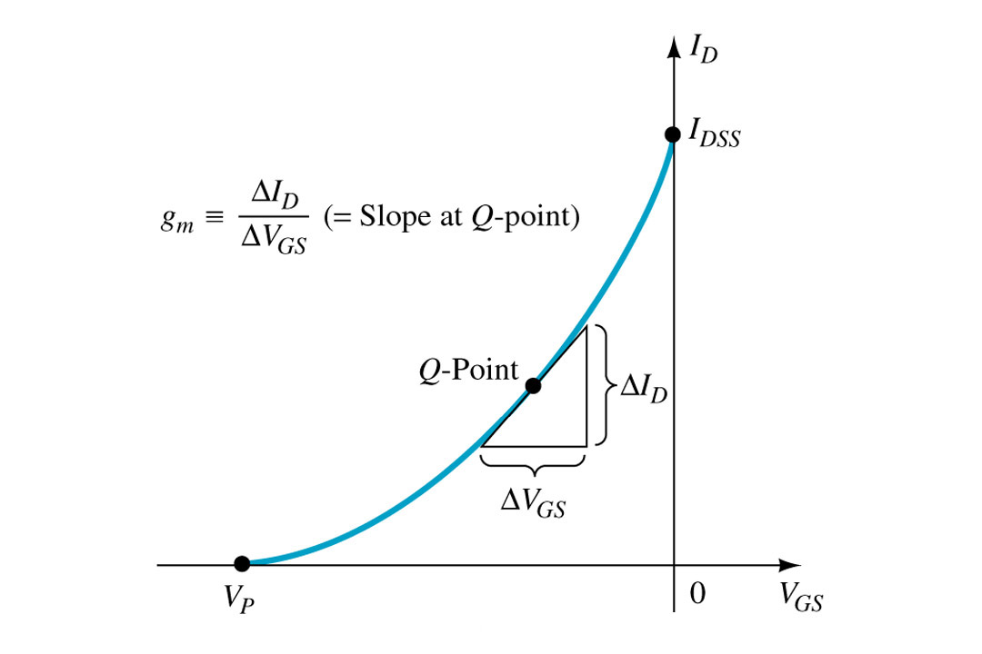
gm at Q

Slide 3
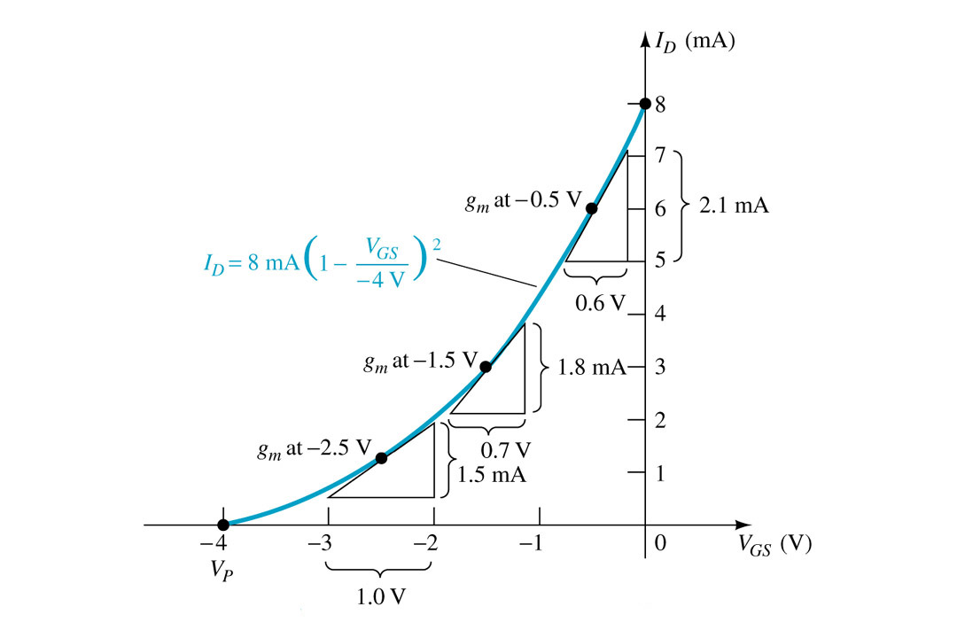
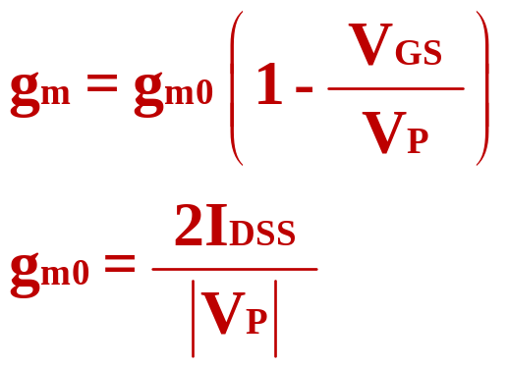
gm varies with VGS

Slide 4
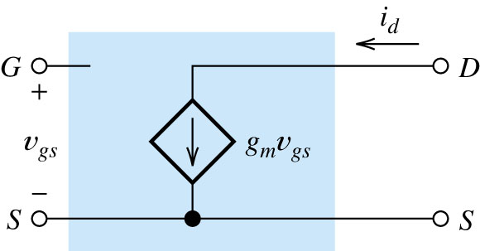
FET Small-signal Equivalent Circuit

Slide 5
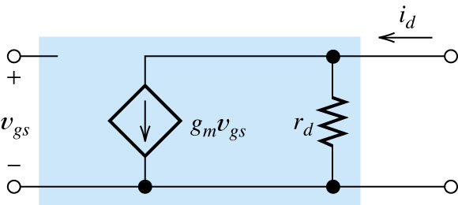
FET Small-signal Equivalent Circuit
FET small-signal equivalent circuit that accounts for the dependence of i_{D} on v_{DS}.

Slide 6
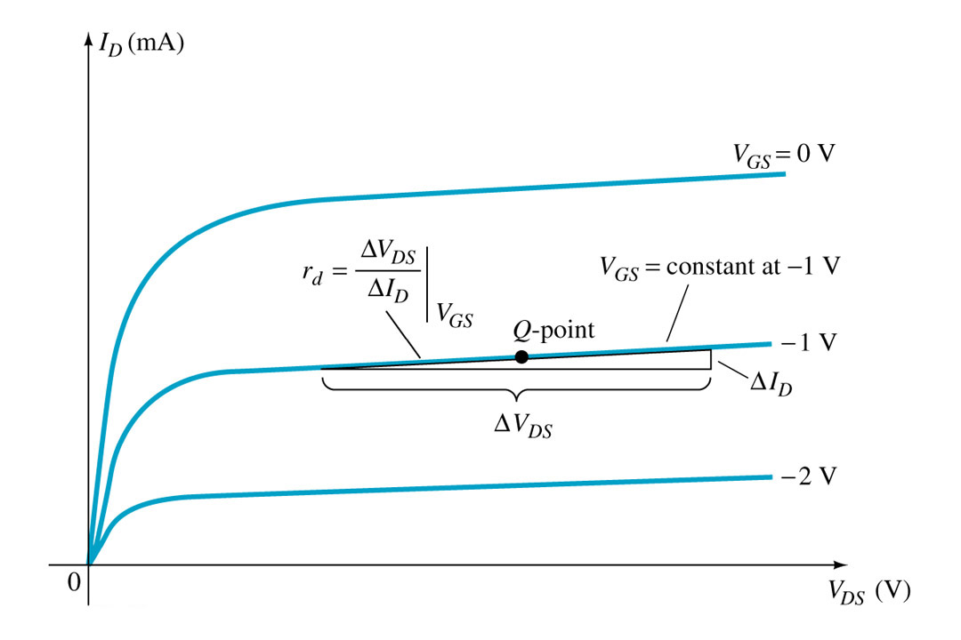
Determination of rd

Slide 7
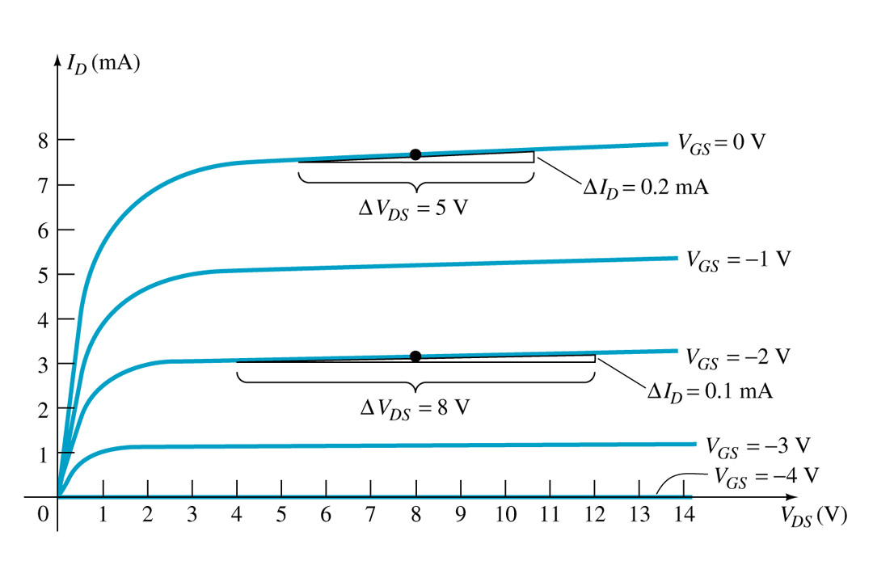
Determination of rd

Slide 8
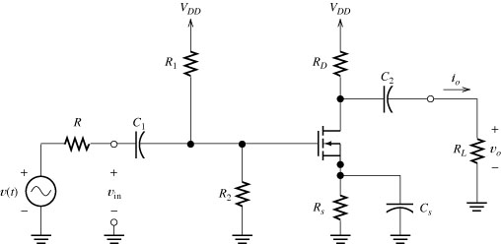
Common-source Amplifier

Slide 9
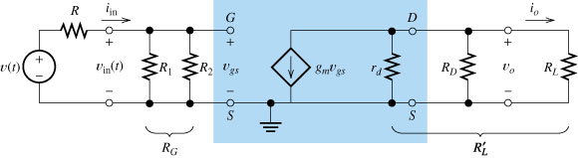
Common-source Small-signal Equivalent Circuit

Slide 10
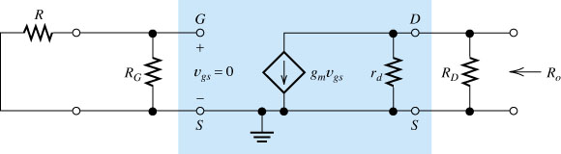

Slide 11
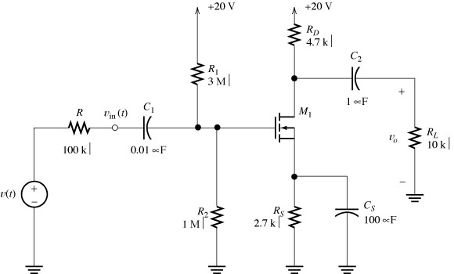
CS Amplifier Voltage Divider Bias
.

Slide 12
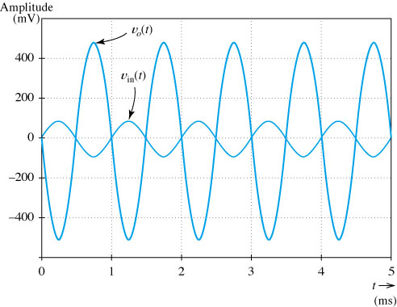
vo(t) and vin(t) versus time

Slide 13
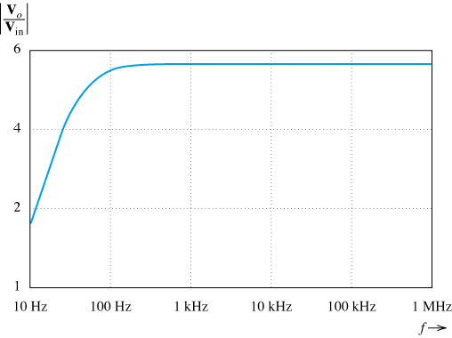
Gain magnitude versus frequency

Slide 14
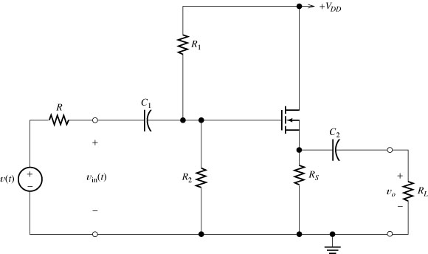
Source Follower

Slide 15
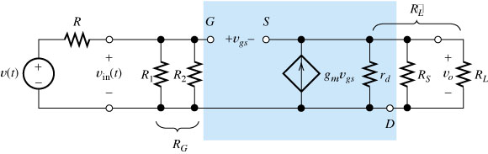
Source Follower Small-signal ac Equivalent

Slide 16
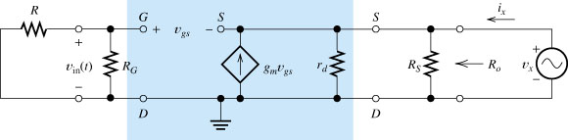
Source Follower Output Resistance

Slide 17
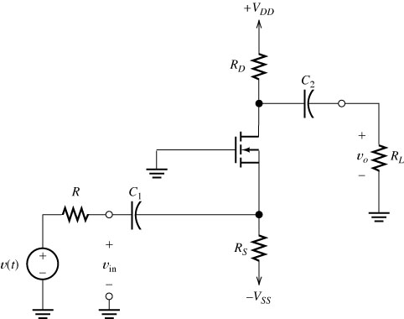
Common Gate Amplifier

Slide 18
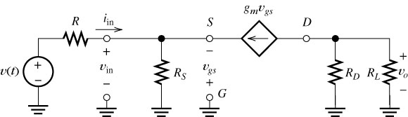
CG AC Equivalent Circuit

